Slide 1
Helpful Tip

Slide 2
Block Comment and Uncomment in VS Code
Select what you want to comment and hit “Ctrl”+”K” then “Ctrl”+”C” to comment everything selected.
“Ctrl”+”K” then “Ctrl”+”C” uncomments selected text.

Slide 3


Slide 4
Documentation

Slide 5
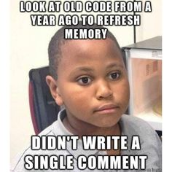

Slide 6


Slide 7
In-Line Comments
Use “#” to input lines the computer won’t read
# Calculate the area
length = 20
width = 40
area = length * width
statement = "The area is " + str(area) + "."
print(statement)

Slide 8
Function (and Class) Documentation
def Add(number1, number2):
'''
Adds the two numbers.
'''
return number1 + number2

Slide 9
Retrieving the Documentation
print(Add.__doc__)
Adds the two numbers.
That is two (2) “_”s on both sides!

Slide 10
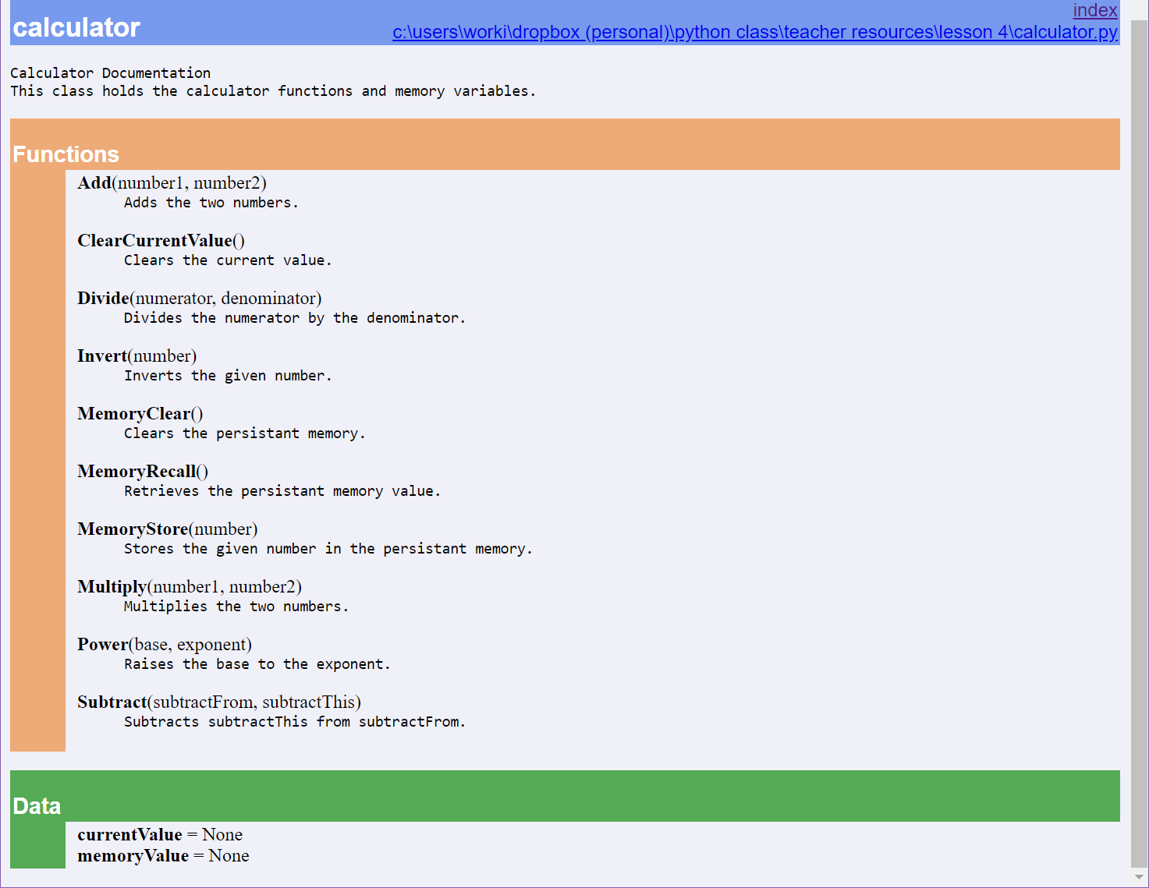
PyDoc

Slide 11
Error Handling

Slide 12
Learning Python p.1127
“In fact, realistic C programs often have as much code devoted to error detection as to doing actual work. But in Python, you don’t have to be so methodical (and neurotic!).”

Slide 13
C++
try {
// code block to try
}
catch (invalid_argument& ex) {
cout << "An invalid-argument exception occurred: " << ex.what () << endl;
}
catch (...) {
cout << "Something besides an invalid-argument exception occurred" << endl;
}
The Python Way:

Slide 14
Python
try:
print(5/0)
except ArithmeticError:
print("You had an arithmetic error.")
except:
print("You cannot do that!")
else:
print("No errors.")

Slide 15
Debugging

Slide 16


Slide 17
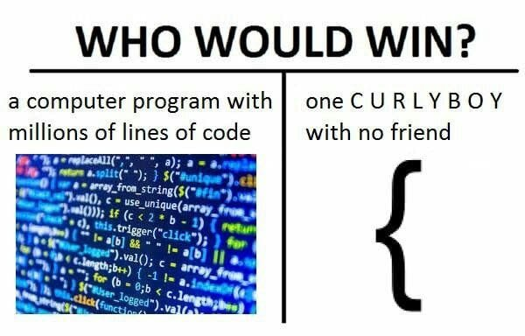

Slide 18
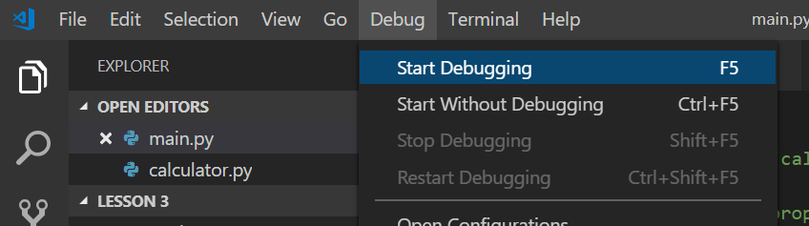
Visual Studio Code Debugger

Slide 19
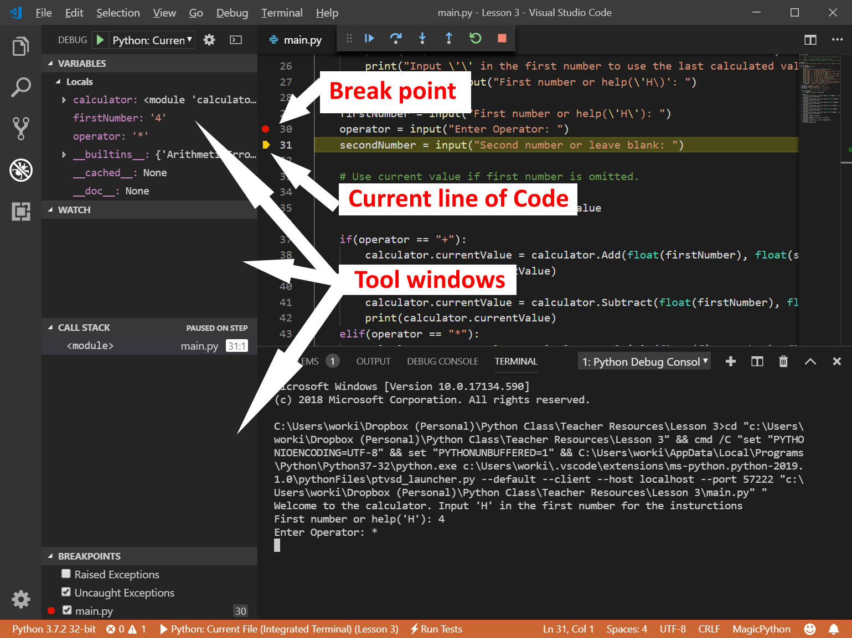

Slide 20
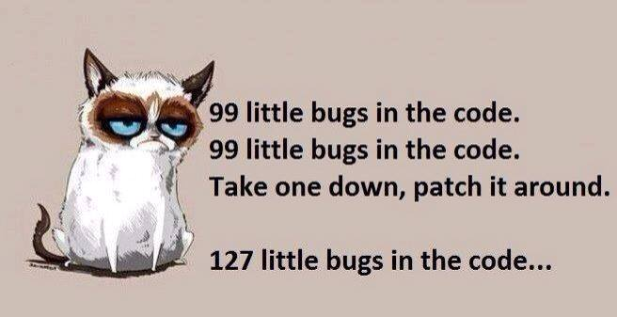

Slide 21
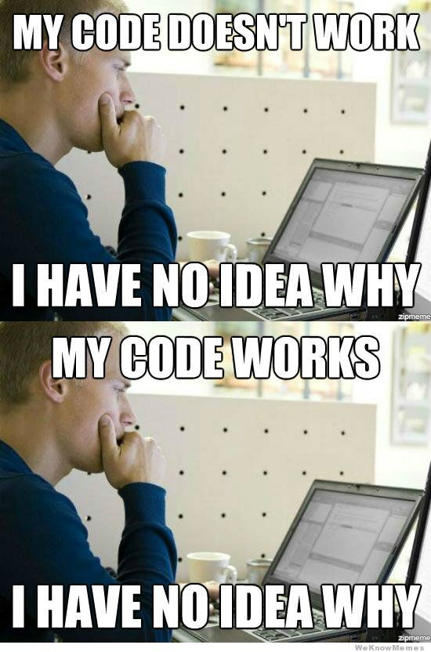

Slide 22
Unit Tests

Slide 23
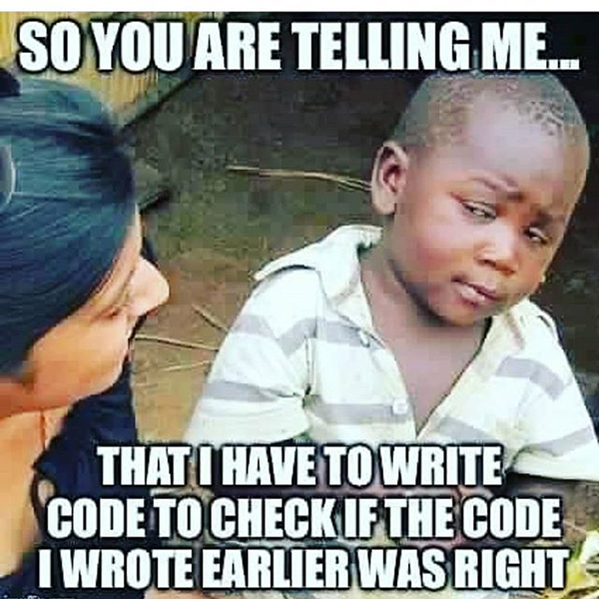

Slide 24
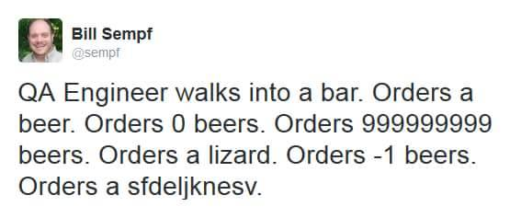

Slide 25
unittest
import unittest
import calculator
class TestAddMethods(unittest.TestCase):
def testPositives(self):
self.assertEqual(calculator.Add(3, 6), 9)
def testNegatives(self):
self.assertEqual(calculator.Add(-3, -4), -7)
if __name__ == '__main__’:
unittest.main()

